Slide 1
Intro to the Wing
airfoils, lift/drag, and more!

Slide 2
Icebreaker - 2 mins
Dig around on our wing CAD model
come up with 1 thing that you want more information on OR a question on the design
Notes:
maya

Slide 3
Agenda
5 min — Ice-Breaker
10 min — parts of a wing + trivia
10 min — Definitions + trivia
5 min — Definition Activity
Notes:
harish

Slide 4
Parts of the Wing

Slide 5
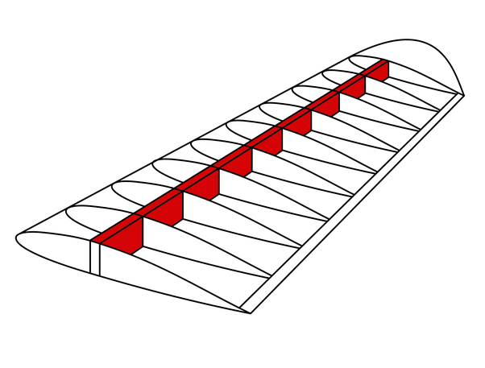
Spar
The spar is the main structural point of the wing, kind of like our spine
Runs vertically along the wing, from the fuselage to the wingtip
There is generally 1 spar per wing, but sometimes there are 2
Notes:
maya

Slide 6
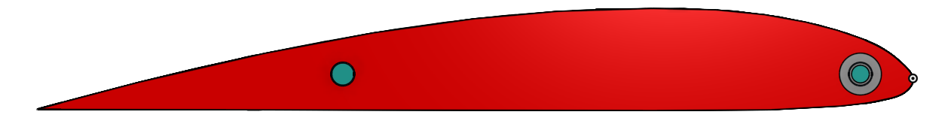
Ribs
cross pieces in the wing - run horizontally
Ribs are attached to the spar
Generate the lift + support the wing
Specific shape called “airfoil”
Notes:
Harish

Slide 7
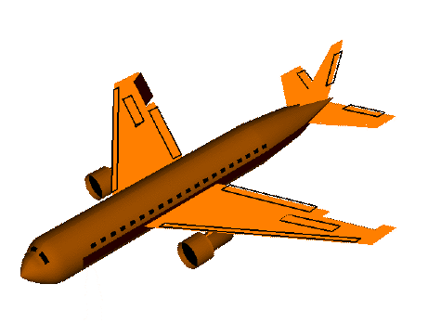
Aileron
A moving part the wings
Used by the pilot to control the roll of the plane
Increases angle of attack, so one side produces more lift than the other side, and the plane tilts. (Also increases drag)
DO NOT CONFUSE WITH FLAPS (Flaps use drag to slow plane to a stop while landing)
Notes:
maya

Slide 8
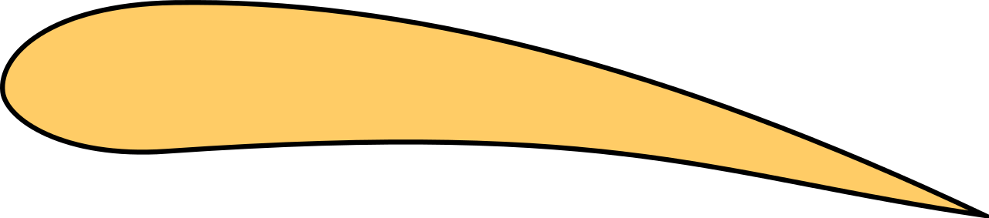
Airfoils
Lift
the side view of a wing
produces lift and drag
remember, lift is an upward force and drag slows the wing down, backwards force
There are lots of different airfoil shapes, each has different uses/benefits
Drag
Notes:
harish

Slide 9
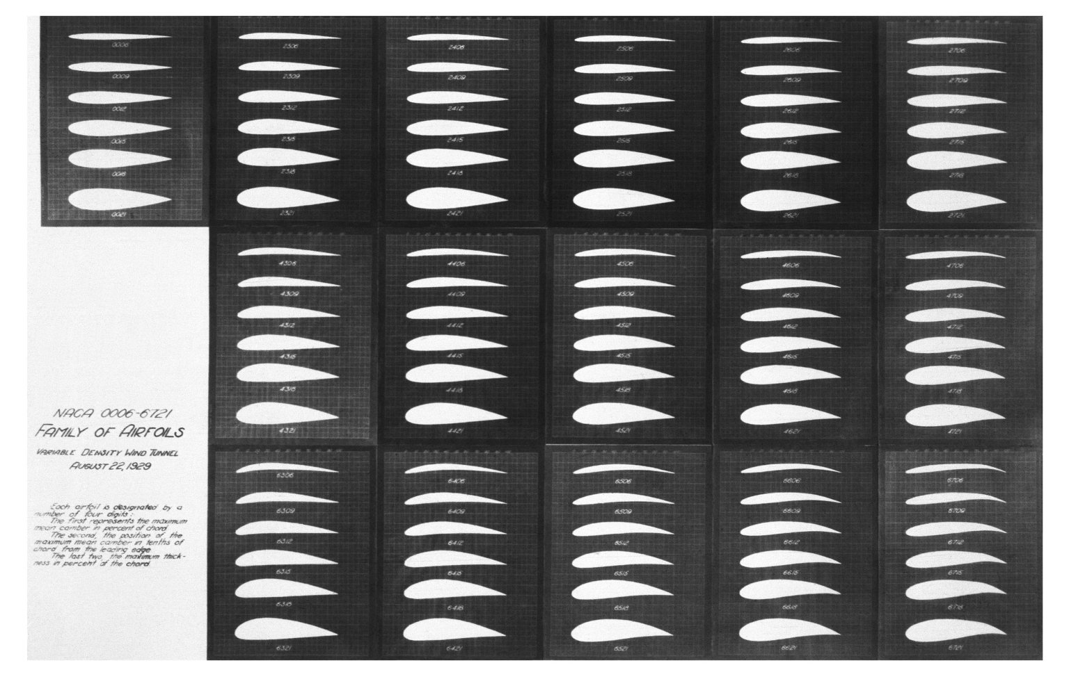
Notes:
maya

Slide 10
Trivia

Slide 11
What is the purpose of a spar?
Reduce drag
Give structure to the wing
Increase lift
Tilt the plane
Notes:
B - maya

Slide 12
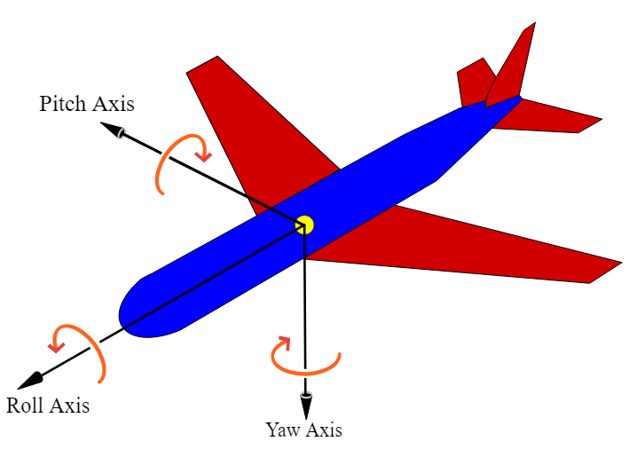
What does the aileron control?
Roll
Tilt/Pitch
Yaw
Notes:
A - harish

Slide 13
What are ribs?
Lift generators
Roll controllers
Extruded airfoils
Both a & c
Notes:
D - maya

Slide 14
Terms

Slide 15
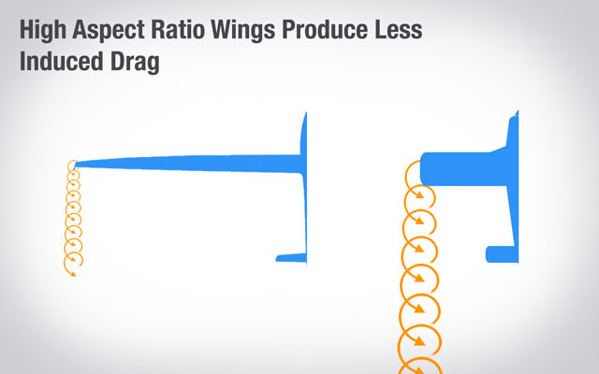
Aspect Ratio
How thin/fat a wing is (high aspect ratio = thin)
Induced Drag: air trying to curl around the tip of a wing
Most is generated this way
Higher, less drag
However, high aspect ratio wings are also harder to make safe
Notes:
harish

Slide 16
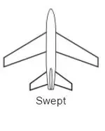
Sweep
Wings slanted forward or back
Swept wings are better for transonic aircraft, front swept is good for structural stability
Our wing is no sweep because it’s the simplest
Notes:
maya

Slide 17
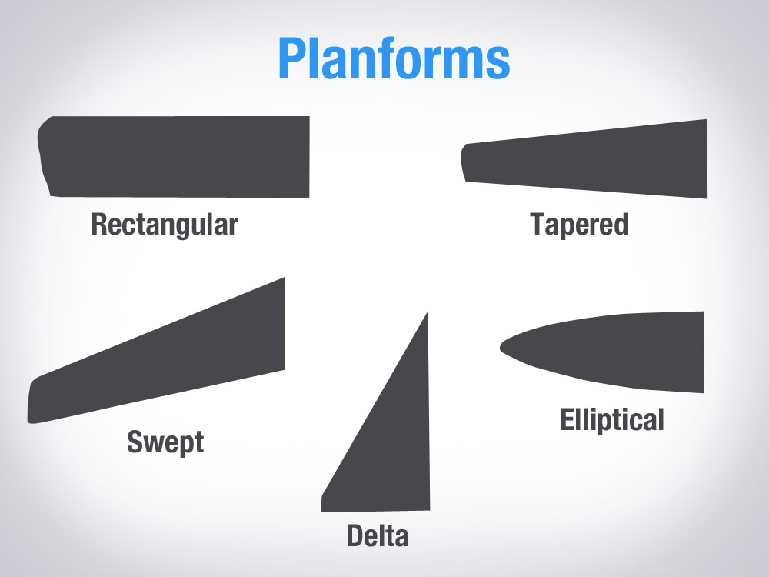
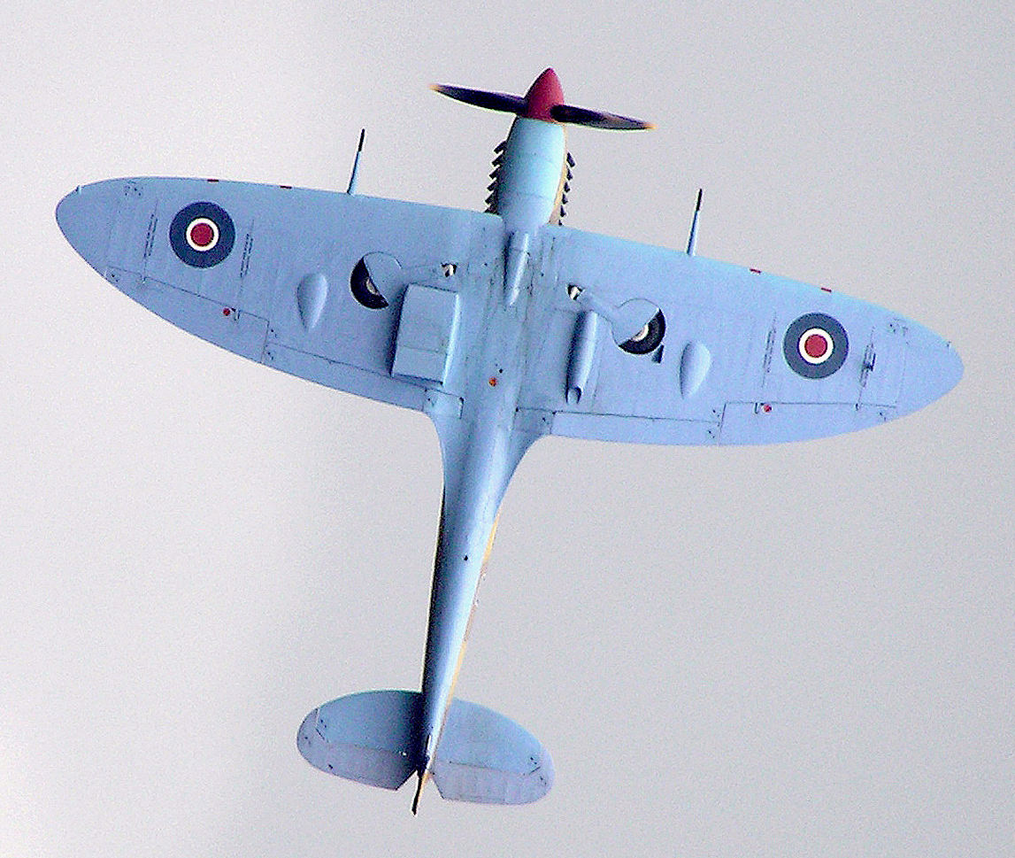
Wing Shape
Rectangular (our wing)
Simple, lots of induced drag
Trapezoidal (commercial aircraft)
Simplish, less induced drag
Elliptical (rounded tips)
Theoretically 0% induced drag, very hard to manufacture
Notes:
harish

Slide 18
Trivia

Slide 19
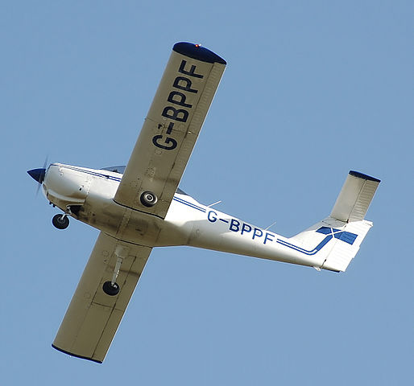
What is the shape of this wing?
Notes:
Rectangular - maya

Slide 20
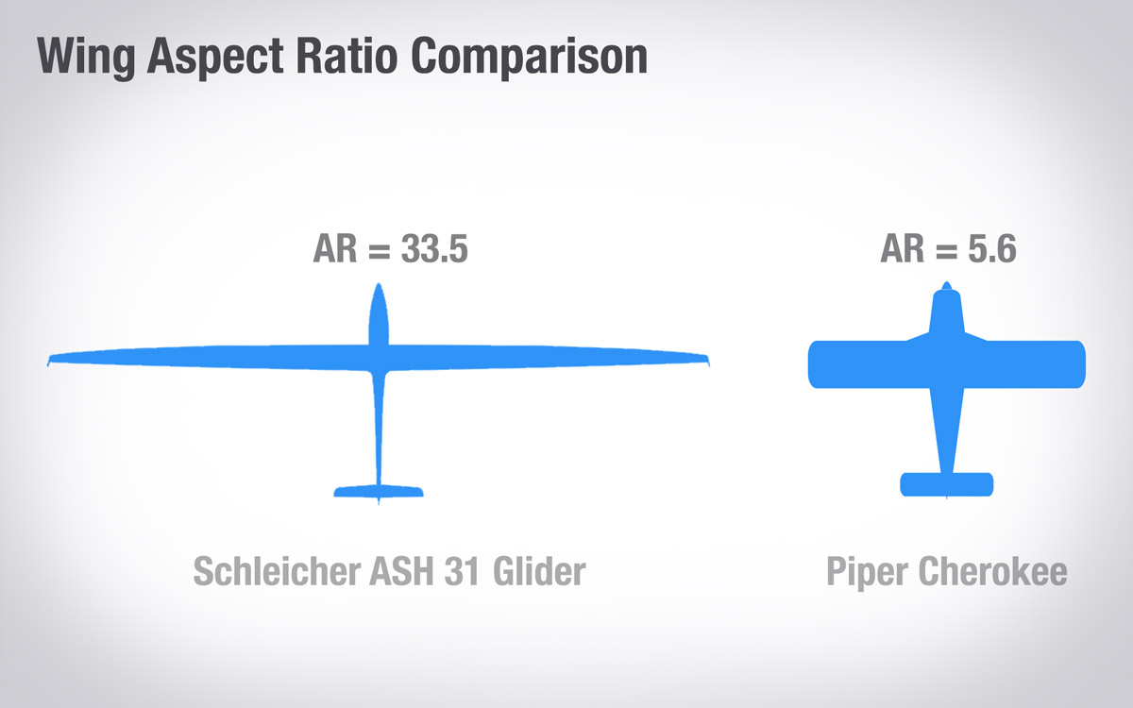
What are the benefits of high aspect ratios?
Higher lift
More structurally stable
Lower drag
Easier to control
Notes:
C - harish

Slide 21
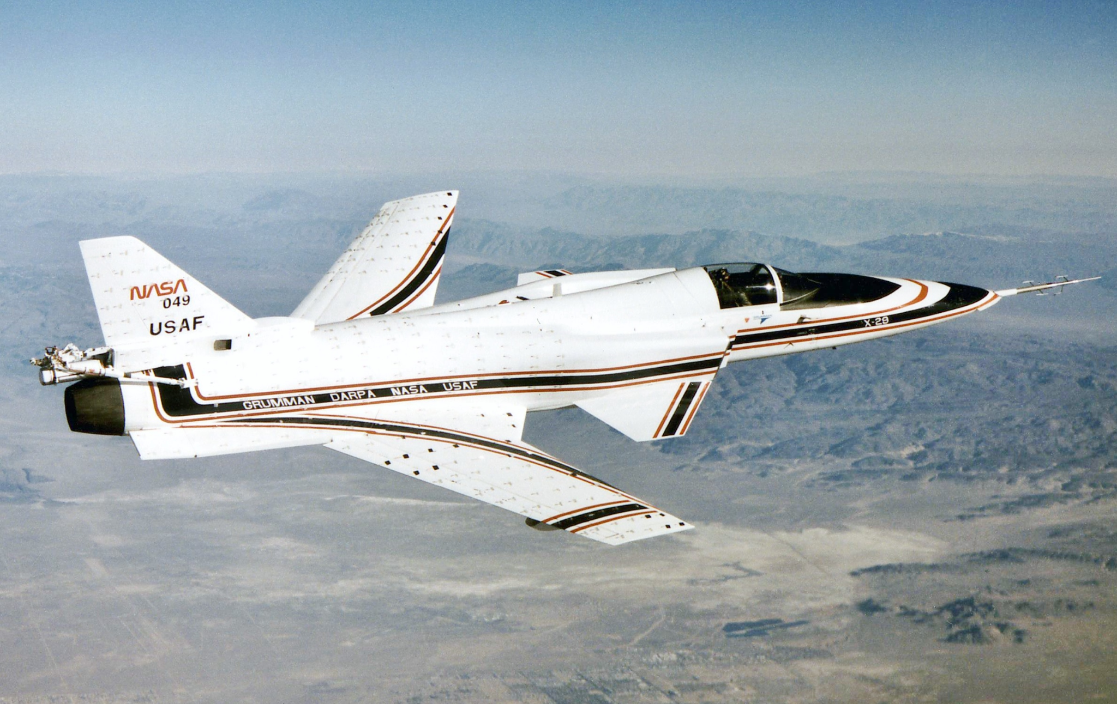
What type of sweep is this, and why do planes use it?
Notes:
Answer: front sweep - better for structural stability
maya

Slide 22
5 min activity
Spend 3 mins researching one of these and explain it to the rest of the group
Chord line
Camber line
Leading edge
Trailing edge
Wing span
Notes:
all

Slide 23
Feedback Form

